Slide 1

Texas State Board of Examiners of Psychologists Panel Discussion:
Board Complaints and Hot Topics
Moderator:
Angela A. Downes, J.D., Board Member
Panel Members:
Donna L. Black, M.A., Board Member
Darrel D. Spinks, Executive Director of TSBEP
Gail Cheramie, Ph.D., Assoc. Professor, Univ. of Houston-Clear Lake

Slide 2
Texas State Board of Examiners of Psychologists
Board Member Date of Term Hometown
Jeff Baker, Ph.D. 2010-2015 League City
Donna Lord Black, M.A. 2007-2017 Frisco
Tim F. Branaman, Ph.D. 2008-2019 Dallas
Jo Ann Campbell, M.S. 2008-2017 Abilene
Carlos R. Chacón 2008-2015 Houston
John Huffman, J.D. 2012-2017 Southlake
Angela A. Downes, J.D. 2008-2019 Dallas
Lou Ann Todd Mock, Ph.D. 2008-2019 Bellaire
Leslie D. Rosenstein, Ph.D. 2010-2015 Dallas

Slide 3
Make-Up of the Board
Section 501.051 of the Psychologists’ Licensing Act reads in part:
(a) The Texas State Board of Examiners of Psychologists consists of nine members appointed by the governor with the advice and consent of the senate as follows:
(1) four psychologist members who have engaged in independent practice, teaching, or research in psychology for at least five years;
(2) two psychological associate members who have been licensed as psychological associates under this chapter for at least five years; and
(3) three members who represent the public.
(a-1) One of the members appointed under Subsection (a)(1) or (a)(2) must practice as a licensed specialist in school psychology under Section 501.260.

Slide 4
House Bill 646
Effective 6/14/2013 (signed by Governor Perry)
Amends Section 501.260 of TX Occupations Code
Adds requirement that one of the members appointed to TSBEP must practice as a licensed specialist in school psychology
Changes do not affect currently serving Board members
  As terms expire, the governor shall appoint or reappoint a member who meets the requirement

Slide 5

Complaints

Slide 6
Complaint Statistics
FY2013-Board disposed of 263 complaints and opened 290 new complaints. Categories of complaints disposed of in FY2013 Administrative Violations – 44 CE Violations – 124 Cease and Desist – 11 Forensic – 42 Of those 42, 27 (64%) were complaints arising out of Custody/Visitation cases General Therapy – 26 School Psychology – 12 (1 reprimand; 1 admin. penalty; 10 dismissals) Sexual Misconduct – 1 Misc. – 3 | FY2014-Board disposed of 251 complaints and opened 243 new complaints. Categories of complaints disposed of in FY2014 Administrative Violations – 18 CE Violations – 143 Cease and Desist – 8 Forensic – 23 Of those 23, 16 (70%) were complaints arising out of Custody/Visitation cases General Therapy – 40 School Psychology – 5 (1 reprimand, 4 dismissals) Sexual Misconduct – 9 Misc. – 5
  Although eligibility proceedings are initiated by the filing of a complaint, they are not disciplinary actions

Slide 7
Complaint Statistics, cont’d
FY2013 | FY2014
Board heard 34 cases at informal settlement conferences -7 were school psychology related Complaints involving school psychology made up 5% of the complaints disposed of -21% of the cases heard at informal settlement conferences | Board heard 28 cases at informal settlement conferences - 0 were school psychology related Complaints involving school psychology made up 2% of the complaints disposed of -0% of the cases heard at informal settlement conferences

Slide 8
Examples of Complaints Resulting in Disciplinary Action
FY2013 Complaints
  LSSP reprimanded for failing to identify any limitations with regard to their opinion, or acknowledge the effects of additional information
  LSSP was assessed an administrative penalty for providing school psychological services outside of the public school setting
FY2014 Complaints
  LSSP reprimanded for failing to timely renew license, and practicing on delinquent status

Slide 9
Conflict between Board Rules and State or Federal Law
Board rule 461.14 – In the event of conflict among state or federal statutes and Board rules, state or federal statute(s) control.
Board rule 465.38(6) - In the event of conflict among state or federal statutes and Board rules, state or federal statute(s) control.
U.S. Const. art. VI, cl. 2, The Supremacy Clause

Slide 10
Areas of Frequent Inquiry
The following areas are some of the more frequently inquired about by LSSPs:
Informed Consent
Records and Record Keeping
Supervision

Slide 11

Informed Consent

Slide 12
Informed Consent
Board rule 465.11, Informed Consent/Describing Psychological Services
Must be in writing prior to delivery of services
Must describe the services being provided and any potential limits on confidentiality
Must be updated with any change in service provided
Must explain the nature of the relationship between the licensee, patient(s), and any third-party
See also Board rule 465.18(c), Forensic Services. The sister rule to the Board’s informed consent rule

Slide 13
Informed Consent
The Board has published two newsletter articles concerning informed consent in the public schools:
Informed Consent in the Public Schools: Analysis of Impact of Federal Education Law on Board Rules Governing Informed Consent
  http://www.tsbep.texas.gov/files/newsletters/Summer2013-Vol-26-No-2.pdf
Informed Consent in Public Schools
  http://www.tsbep.texas.gov/files/newsletters/Spring2014_Newsletter_Vol_27_No_2.pdf

Slide 14
Informed Consent
In public schools, there are three types of activities requiring informed consent
Special education evaluation
Special education services
General education consultation

Slide 15
Informed Consent:
Special Education Evaluation

Slide 16
Special Education: Consent for Evaluation
The LEA must make reasonable efforts to obtain informed consent for an evaluation which includes:
  Detailed records of telephone calls made or attempted and the results of those calls;
  Copies of correspondence sent to the parents and any responses received; and
  Detailed records of visits made to the parent ’s home or place of employment and the results of those visits.
  [34 CFR §300.322(d)]

Slide 17
Initial Evaluation:
Student Enrolled or Seeking Enrollment in Public School
Parent Fails to Respond or Refuses Consent
The LEA may, but is not required to, pursue the initial evaluation of the child by utilizing the procedural safeguards, including the mediation or the due process hearing procedures, in order to obtain agreement or a ruling that the evaluation may be conducted; and
The LEA does not violate its obligation under child find duty and evaluation procedures if it declines to pursue the evaluation.
  [34 CFR §300.300(a)(3)]

Slide 18
Initial Evaluation:
Student is Home-Schooled or Private-Schooled
Parent Fails to Respond or Refuses Consent
The LEA may not pursue the initial evaluation by utilizing the procedural safeguards, including the mediation or due process hearing procedures, in order to obtain agreement or a ruling that the evaluation may be conducted; and
The LEA is not required to consider the child as eligible for services under the proportionate share funding for parentally-placed private school child and private schools frameworks.
  [34 CFR §300.300(d)(4)]

Slide 19
Initial Evaluation:
Student is a Ward of the State (not with parent)
The LEA is not required to obtain informed consent from the parent if:
Despite reasonable efforts to do so, the LEA cannot discover the whereabouts of the parent of the child;
The rights of the parents of the child have been terminated in accordance with state law; or
The rights of the parent to make educational decisions have been substituted by a judge in accordance with state law and consent for an initial evaluation has been given by an individual appointed by the judge to represent the child.
  [34 CFR §300.300(a)(2)]

Slide 20
Informed Consent: Additional Information
Parental consent for an initial evaluation does not constitute CONSENT FOR SERVICES. 34 CFR §300.300(a)(1)(ii)
A separate consent for a psychological evaluation is not needed. 34 CFR § 300.304(c)(4) & (6)

Slide 21
Reevaluation: Parent Fails to Respond
No consent is required if the LEA can demonstrate
  Reasonable efforts were made to obtain parental consent; and (despite these efforts)
  The parent failed to respond
[34 CFR §300.300(c)(2)]

Slide 22
Reevaluation:
Students in Private School or Home Schooled
Parent fails to respond or refuses consent:
The LEA may not pursue the reevaluation by using the procedural safeguards (including the mediation or due process procedures) in order to obtain agreement or a ruling that the evaluation may be conducted; and [34 CFR §300.300(d)(4)(i)]
The LEA is not required to consider the child as eligible for services under the proportionate share funding for parentally-placed private school child and private schools frameworks. [34 CFR §300.300(d)(4)(ii)]

Slide 23
Reevaluation:
Students Enrolled in Public School
Parent Refuses Consent
The LEA may, but is not required to, pursue the reevaluation by using the procedural safeguards (including the mediation or due process procedures) in order to obtain agreement or a ruling that the evaluation may be conducted; and [34 CFR §300.300(c)(1)(ii)]
The LEA does not violate its obligation under child find duty and evaluation procedures if it declines to pursue the reevaluation. [34 CFR §300.300(c)(1)(iii)]

Slide 24
Revocation of consent for initial evaluation or reevaluation is not retroactive (i.e., it does not negate actions that occurred after consent was given or before consent was revoked.
34 CFR 300.9(c)(2)
Parent Revokes Consent

Slide 25
Actions Not Considered an Evaluation
(thus, no consent required)
Screening to determine strategies for curriculum implementation;
Conducting a Review of Existing Evaluation Data (REED) as part of an initial evaluation or a reevaluation; and
Administering a test or other evaluation that is administered to all children.
34 CFR §300.300(d)(1)(ii)

Slide 26
Informed Consent:
Special Education Services

Slide 27
Consent for Services
  The LEA must make reasonable efforts to obtain informed consent for the initial provision of services which includes:
  Detailed records of telephone calls made or attempted and the results of those calls;
  Copies of correspondence sent to the parents and any responses received; and
  Detailed records of visits made to the parent ’s home or place of employment and the results of those visits.
  [34 CFR §300.322(d)]

Slide 28
Consent for Services
If the parent refuses to respond or refuses to consent to the initial provision of special education and related services, the LEA:
  May not use the procedural safeguards (including the mediation or the due process procedures) in order to obtain agreement or a ruling that services may be provided to the child;
  Will not be considered to be in violation of the requirement to make available a free appropriate public education (FAPE) to the child because of the failure to provide the child with the special education and related services for which the LEA requests consent; and
  Is not required to convene an admission, review and dismissal (ARD) committee meeting or develop an individualized education program (IEP) for the child, as defined in the rule of construction framework.

Slide 29
Consent for Services
When consent for services is revoked after the initial provision of services [34 CFR §300.300(b)(4)]
  The revocation must be in writing
  The LEA
    May not continue to provide special education and related services to the child
    Must provide prior written notice before ceasing to provide special education and related service
    (continued on next slide…)

Slide 30
Consent for Services
The LEA (continued)
    May not use the procedural safeguards (including the mediation procedures or the due process procedures) in order to obtain agreement or a ruling that the services may be provided to the child
    Will not be considered to be in violation of the requirement to make a FAPE available to the child because of the failure to provide the child with further special education and related services; and
    Is not required to convene an ARD committee meeting or develop an IEP for further provision of special education and related services for the child, as defined in rule of construction.

Slide 31
Informed Consent:
General Education
See Handouts:
Informed Consent in the Public Schools: Analysis of Impact of Federal Education Law on Board Rules Governing Informed Consent
Informed Consent in the Public Schools

Slide 32
Regulatory Authority of TSBEP
TSBEP does not regulate school districts; it regulates the use of titles and the “activities” of the individuals licensed by the Board (which includes LSSPs)
The “activities” performed by LSSPs that are subject to Board regulatory authority are the activities that constitute psychological services [Board Rule 465.1(10)]
Some “activities” performed by LSSPs may be considered “educational services” and not “psychological services”
(continued on next slide...)

Slide 33
Educational or Psychological Service?
Questions to help determine the type of activity:
Does the activity require the individual to hold a specific license or credential to provide that activity in the public school?
Is the activity solely reliant upon specialized education and training in psychology and psychological principles (such as that held by an LSSP)?
Is the activity “psychological” in nature (i.e., would it constitute the practice of psychology as defined by TSBEP and the Psychologist’s Licensing Act)?
Does the activity involve direct student services (i.e., services that are not under the direct authority of the teacher or another staff member)?

Slide 34

Records and Record Keeping

Slide 35
Records and Record Keeping
465.22, Psychological Records, Test Data and Test Protocols
(a)(6) – Licensees working in public school settings shall comply with all federal and state laws and regulations relative to the content, maintenance, control, access, retention and destruction of psychological and educational records, test data and test protocols.
(b)(6) – Records and test data of psychological services rendered by an employee of an agency or organization belong to the employer, unless provided otherwise by law or agreement.

Slide 36
Records and Record Keeping
465.22(c), Access to Records and Test Data
  “Test Data” is defined in 465.1(14) as “testing materials, test booklets, test forms, test protocols and answer sheets used in psychological testing to generate test results and test reports.”
465.22(d)(2), Retention of Records
  In the absence of other applicable law, records must be kept for a minimum of 7 yrs. after termination of services, or until the client turns 21, which ever is longer.

Slide 37
Records and Record Keeping

Slide 38
Legal Framework, Applicable Laws
Under the category of Records, the following “authorities” are listed as governing Records:
34 C.F.R. Parts 75, 80, 99 and 300
20 U.S.C. §1414, 1415, 1232(g); 26 U.S.C. §152
19 T.A.C. Chapter 89, Chapter 101
Texas Government Code
Texas Local Government Code
Texas Education Code
Texas Family Code

Slide 39
Applicable Laws
Texas State Library and Archives Commission, Local Schedule SD
Retention Schedule for Records of Public School Districts (42-page document)
  Part 2: FERPA regulations
  Part 3: Special Populations and Services
  Part 7: Discipline and Counseling
HANDOUT

Slide 40
Special Education Records (§3-1)
Records of each student referred to or receiving special education services, including referral, assessment, and reevaluation reports; enrollment and eligibility forms; admission, review, and dismissal (ARD) and transitional planning committee documentation; individual educational plans (IEP) and individual transitional plans (ITP); parental consent forms for testing and placement; and other records of services required under federal and state regulation.

Slide 41
Bilingual Records (§3-2)
Records of each student referred to or receiving bilingual or special language services, including recommendations from parents or teachers for bilingual instruction, student interview documentation, notifications to parents, parental consents or denials, language proficiency assessment committee (LPAC) reports, exit reports, follow-up study reports, and other records of services required by state regulation or pertinent to the identification of students for bilingual education or special language programs

Slide 42
504 Records (§3-4)
Records of each student referred to or receiving services under Section 504, including referral, pre-placement, and reevaluation reports, parental notices; group and impartial hearing deliberations; and other records of services required under Section 504 regulations

Slide 43
Dyslexia Records (§3-5)
Records of each student referred to or receiving dyslexia program services, including referral and assessment reports; group deliberations; parental notices; and other records of services required under state regulations

Slide 44
Retention of Records
For the special education, 504 and special program records noted on previous slides: Retention: Cessation of services +5 years
Prior to destruction, eligible student or parents must be notified

Slide 45
Part 7: Discipline & Counseling Records
Records relating to removal to a Disciplinary Alternative Education Program, suspension, or expulsion = 5 years
Individual student counseling files maintained by school counselors, including parental conference reports. AV (as long as administratively valuable)
Retention Note: It is an exception to the retention period for this record group that guidance and counseling files programmatically associated with participation in special programs as described in Part 3 of this schedule must be retained for the same period as the student records for the special program. In addition, records of counseling in any federally funded special guidance or counseling project or program must be retained for 5 years beyond cessation of counseling services to the student.

Slide 46
19 Texas Administrative Code § 89.1075
General Program Requirements and Local District Procedures.
(a) Each school district shall maintain an eligibility folder for each student receiving special education services, in addition to the student's cumulative record. The eligibility folder must include, but need not be limited to: copies of referral data; documentation of notices and consents; evaluation reports and supporting data; admission, review, and dismissal (ARD) committee reports; and the student's individualized education programs (IEPs).

Slide 47
34 Code of Federal Regulations § 300.501
Opportunity to examine records; parent participation in meetings.
(a) Opportunity to examine records
The parents of a child with a disability must be afforded, in accordance with the procedures of §§ 300.613 through 300.621, an opportunity to inspect and review all education records with respect to —
(1) The identification, evaluation, and educational placement of the child; and
(2) The provision of FAPE to the child.

Slide 48
34 C.F.R.§ 99.20 and 300.618
Amendment of the student's education records?
If a parent or eligible student believes the education records relating to the student contain information that is inaccurate, misleading, or in violation of the student's rights of privacy or other rights, he or she may ask the educational agency or institution that maintains the information to amend the record/information.

Slide 49
34 CFR § 99.20 and 300.618
(c) If the agency decides to refuse to amend the information in accordance with the request, it must inform the parent of the refusal and advise the parent of the right to a hearing under § 300.619.

Slide 50
Key Concepts for LSSPs
Accuracy
Comprehensiveness
Documentation of Progress, Measurable
Inspect and Review
Be very careful about destruction – you should know your district’s policy about this.
Review Legal Framework!

Slide 51

Supervision

Slide 52
Supervision
465.2, Supervision
Board rules governing supervision are very broad, and the nature and amount of supervision necessary is left to the discretion of the supervisor based upon a totality of the circumstances
  Generally, 465.2 requires that the level of supervision provided be adequate based upon accepted professional standards given the experience, skill and training of the supervisee and the type of psychological services provided
465.38(4) and (5) addresses supervision requirements unique to LSSPs

Slide 53
Supervision
The Board is in the process of conducting a review and revision to its rules governing the supervision of those acquiring the supervised experienced necessary for licensure, as well as the supervision required for practice by provisionally licensed psychologists, psychological associates, and specialists in school psychology.
This process began in October 2012, and is expected to be completed in fiscal year 2015. The objective is to further clarify the legal requirements for the delivery of psychological services under supervision, and increase the measure of protection afforded the public.
To aid in this process, the Board has engaged the use of an ad hoc advisory committee made up of stakeholders pursuant to Tex. Gov’t Code Ann. §2001.031.

Slide 54
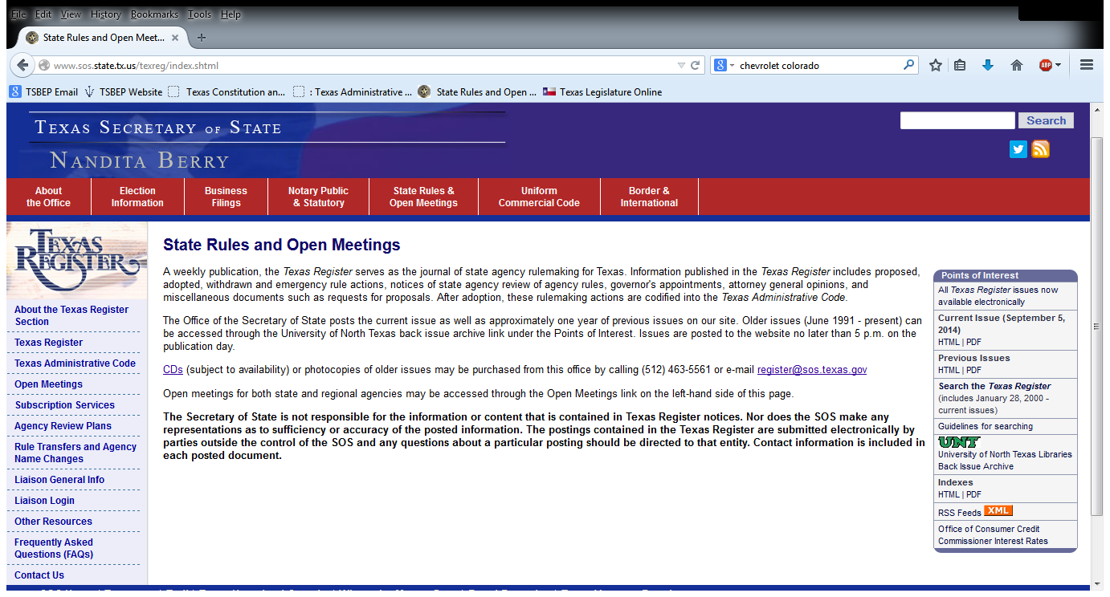
How Do I Keep Up-to-Date With Board Rule Changes?
The Texas Register may be found at http://www.sos.state.tx.us/texreg/index.shtml

Slide 55
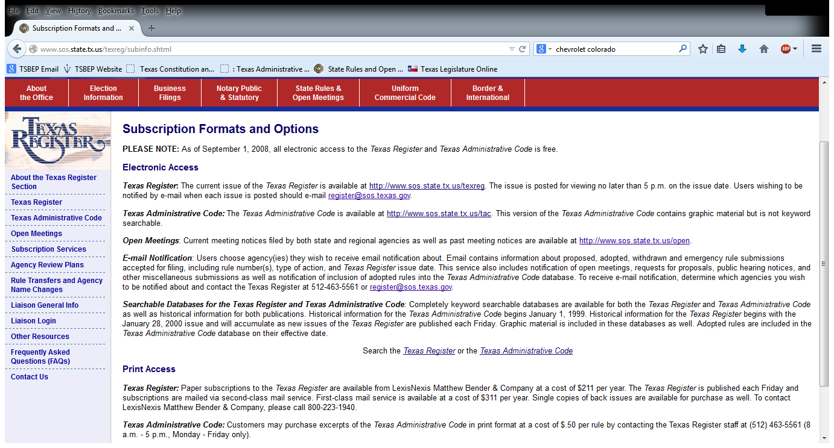
You may also register to receive email notifications of when the latest edition of the Texas Register has been published
http://www.sos.state.tx.us/texreg/subinfo.shtml

Slide 56

???Questions???
“Ask me no questions, and I’ll tell you no lies.” – Oliver Goldsmith

Slide 57
Overview of the Complaint Process
§501.204 of the Psychologists’ Licensing Act, General Rules Regarding Complaint Investigation and Disposition:
Ensure that a complaint is not dismissed without appropriate consideration
Advise Board and Complainant of dismissal
  While Board Staff could dismiss complaints under statute, Staff do not. Dismissal occurs by full Board only, following recommendation by Staff or ISC Panel.

Slide 58
Overview of the Complaint Process, cont’d
Allow each Complainant an opportunity to explain his/her allegations
Dispose of complaints in a timely manner
Board to prioritize complaints
  Priority 1 cases: imminent physical harm to the public
  Priority 2 cases: sexual misconduct by a licensee
  Priority 3 cases: violations by applicants
  Priority 4 cases: all other violations

Slide 59
Overview of the Complaint Process, cont’d
Title 22, Pt. 21, Ch. 469, Complaints and Enforcement, of the TAC
  Rules governing procedure of complaint process
469.1, Limitations:
  General Rule-5 yrs following termination of services or receipt of notice of disciplinary action from other jurisdiction
  Sexual Misconduct and Records Violation-7 yrs following termination of services or 3 yrs following age of majority, whichever is greater

Slide 60
Overview of the Complaint Process, cont’d
469.5, Complaint Disposition:
  Complaints that do not state a violation on their face, are recommended for dismissal without notice ever being sent to licensee
  Complaints that if taken as true, state a violation, must be investigated
  Following investigation, if P.C. exists, the Enforcement Manager and G.C. set the complaint for a hearing at the Board’s I.S.C.

Slide 61
Overview of the Complaint Process, cont’d
Title 22, Pt. 21, Ch. 470, Administrative Procedure, of the TAC
470.8, Informal Disposition of Complaints:
  An informal disposition may be made of any complaint by stipulation, agreed settlement, consent order, default, or dismissal in accordance with Tex. Gov’t Code Ann. §2001.056.
  I.S.C. Panel made up of three Board members, the E.D., G.C. Enforcement Manager, and Investigator
  Complainant and licensee may present evidence and witnesses, separately from one another, at the I.S.C.
470.12, Contested Cases Referred to the State Office of Administrative Hearings:
  In the event a complaint is not disposed of informally, the complaint is referred to the State Office of Administrative Hearings per Board rule 470.12.

Slide 62
Overview of the Complaint Process, cont’d
Summary of Complaint Process:
  Complaint received by the Board
  Investigator reviews to determine whether a violation has been stated on face of complaint
    If not, complaint is referred to SDM and ultimately full Board for dismissal
    If so, complaint is sent to Investigations
  Licensee is sent NOV and investigation ensues
    If no P.C. found, complaint is referred to SDM and ultimately full Board for dismissal
    If P.C. found, licensee is either sent a proposed agreed order or invited to I.S.C.
  Informal Settlement Conference
    If panel recommends sanction, proposed agreed order sent
    If panel recommends dismissal, complaint is referred to full Board for dismissal
  Informal vs. Formal Disposition of Complaints
    Complaints resolved informally following ISC are referred to full Board for final disposition
    Contested complaints are referred to SOAH for a contested hearing
  Full Board disposes of complaints resolved informally or following a contested hearing at SOAH
  Appeal of Board’s decision in contested case through the state court system

Slide 63
Overview of the Complaint Process, cont’d
Types of disciplinary action taken by the Board:
  Revocation
  Suspension
  Probated Suspension(either in whole or in part)
  Reprimand
  Administrative Penalty
Board may also impose other reasonable terms and conditions upon a licensee who receives a sanction.
§501.158 of the Act, Competency Requirements
  Board may require, upon reasonable belief, a licensee to submit to a physical or mental exam to determine their fitness to practice.
    Failure to abide by a Board directive to submit to the examination would constitute a violation of Board rules 461.15 and 465.35(c).

Slide 64
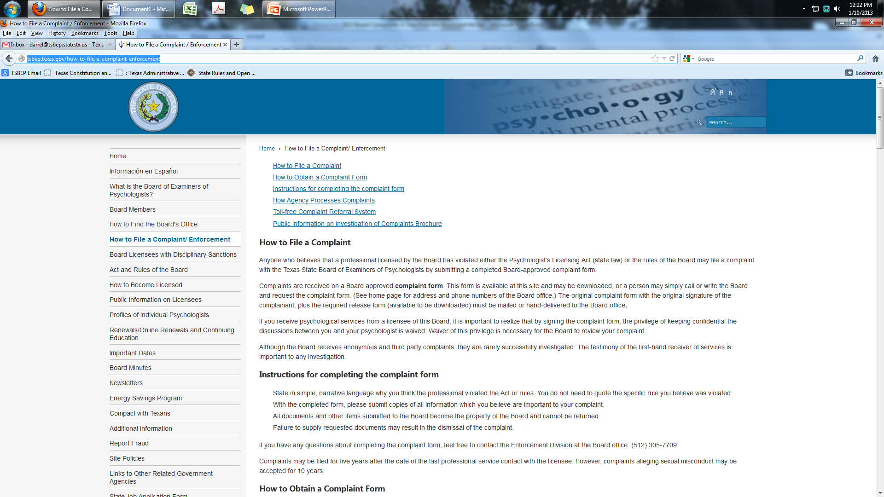
Overview of the Complaint Process, cont’d
The Board’s website contains a general discussion of the complaint process at:
http://tsbep.texas.gov/how-to-file-a-complaint-enforcement

